Slide 1
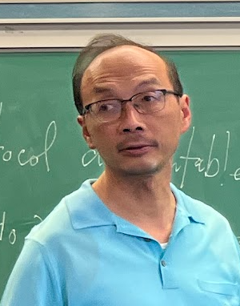
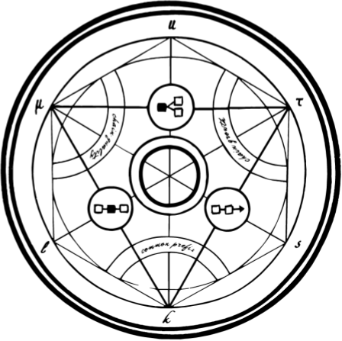
Rollerblade Replicated Distributed Protocol Emulation on Top of Ledgers
Dionysis Zindros
Apostolos Tzinas
NTUA & Common Prefix
David Tse
Stanford University
May 23rd, 2024 – ATHECRYPT 2024

Slide 2
Reliability in Circuits
A
B

Slide 3
Reliability in Circuits
A
B

Slide 4
Log protocol: An ordering service
transactions
log
{
}
BTC
[
]

Slide 5
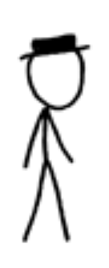
Log protocol: An ordering service
parties
Bitcoin network
Streamlet network
“mempool”
BTC
honest
[
]
[
]
locally
ordered
transactions
globally
ordered
transactions
network
safety
]
BTC
honest
[
[
]
adversary
liveness

Slide 6
Reliability in Logs
tx
L

Slide 7
Reliability in Logs
tx
tx
tx
tx
BTC
ETH
AVA
L
L
L
how do we compose these logs?
L
Notes:
Ledger protocols may fail (due to e.g., 51% attacks)
But we have many ledger protocols running today
Bitcoin, Ethereum, Cardano, etc.
Can we make a reliable construction?
Compose them: If one fails, the system survives
Compositor drawing with underlyings
The compositor takes in txs and gives ledgers

Slide 8
The setting: The compositor ledger
we want safety
[
]
overlay
transaction
(separate coin)
L =
[
]
overlay
log
tx
Λ
Λ
compositor
no honesty assumption among compositors
no direct communication
secure majority
×
underlying
log
BTC
ETH
AVA
BTC
ETH
AVA
different clients to the same log protocol instance
safety is promised
…and more Λs
Notes:
We want the compositor ledger to be safe/live (secure)
The compositor ledger is a “separate” ledger (and its coin can also be separate)
We will not care about bridging from/to other ledgers
We want a construction that gives reliability, but will not concern ourselves about performance

Slide 9
Security theorem (informal)
If the majority of the underlying are secure logs (safe & live).
Then Rollerblade is a secure log (safe & live).

Slide 10
Warm-up solution: Take a majority vote
[
]
{
}
M
even secure chains may disagree on order
[
]
[
]
[
]
bulletin
BTC
ETH
AVA

Slide 11
This doesn’t work: Condorcet cycles
A:
B:
C:

Slide 12
Ordering between different parties
parties
Streamlet network
“mempool”
honest
[
]
[
]
locally
ordered
transactions
globally
ordered
transactions
safety
honest
[
]
[
]
adversary

Slide 13
Ordering between different logs
logs
Streamlet network
“underlying logs”
“overlay log”
secure
BTC
[
]
[
]
“locally”
ordered
transactions
globally
ordered
transactions
safety
secure
ETH
[
]
[
]
secure log corresponds to honest party
×
a log corresponds to a party
insecure
AVA
we just need to run another log protocol on top !

Slide 14
Our construction: Rollerblade
[
]
M
majority voting now works
any classical consensus protocol Π
emulated Streamlet network
one compositor
Z¹
Z²
streamlet validators
Z³
×
BTC
ETH
AVA

Slide 15
Emulating the collective execution of parties
tx in
streamlet validators
Z¹
Z²
Z³
net out
net in
networking

Slide 16
Details: The emulation of Z¹
Π party Z¹ is emulated by giving it inputs deduced
from its respective underlying log
tx in
Z¹
net in
“write” transactions
“incoming network message” transactions
BTC

Slide 17
Details: Emulating transaction writing
transaction writing passed to underlying log
returns to overlay instance through log
Z¹
Z²
Z³
BTC
ETH
AVA
[
]

Slide 18
Details: Transcribing logs
We assume the underlying can be transcribed into certificates
L = [
]
“write”
“read”
“transcribe”
ETH
“untranscribe”
certificate c
L = [
]
These certificates cannot be forged

Slide 19
Details: Emulating the network
Z¹
Z²
net out
message from Z¹ to Z²
net in
message from Z¹ to Z²
decode
encode
bulletin tx
encode
net message
bulletin tx
decode and untranscribe
BTC
ETH
[
]
certificate for log
Bitcoin log
transcribe
[
]
[
]
Bitcoin log
Ethereum log

Slide 20
Our result: Emulation Theorem
Theorem (Emulation – informal):
For any (suitable) protocol Π, the emulated execution is indistinguishable from a real execution in the view of honest parties.
The honest parties cannot tell if they’re being emulated.
Z¹
Z²
Z³
emulated setting
×
BTC
ETH
AVA
≈
Corollary (Metatheorem - informal):
Any theorem about Π in the party setting translates to a theorem about Π in the emulated setting
Z¹
Z²
Z³
party setting

Slide 21
Our result: Replication Consistency
Z¹
Z²
Z³
≈
Z¹
Z²
Z³
×
×
BTC
ETH
AVA
BTC
ETH
AVA
Theorem (Replication – informal):
The execution of the overlay protocol Π is the same regardless of the compositor Λ that facilitates it.
This follows from the safety of the underlying,
and the determinism of Π.

Slide 22
Consensus result
Theorem (Security – informal)
If the majority of the underlying are secure logs (safe & live).
Then Rollerblade with Streamlet is a secure log (safe & live).
This follows from the emulation theorem, the replication theorem, and the security theorem of Streamlet. The same theorem follows for any secure overlay Π.

Slide 23
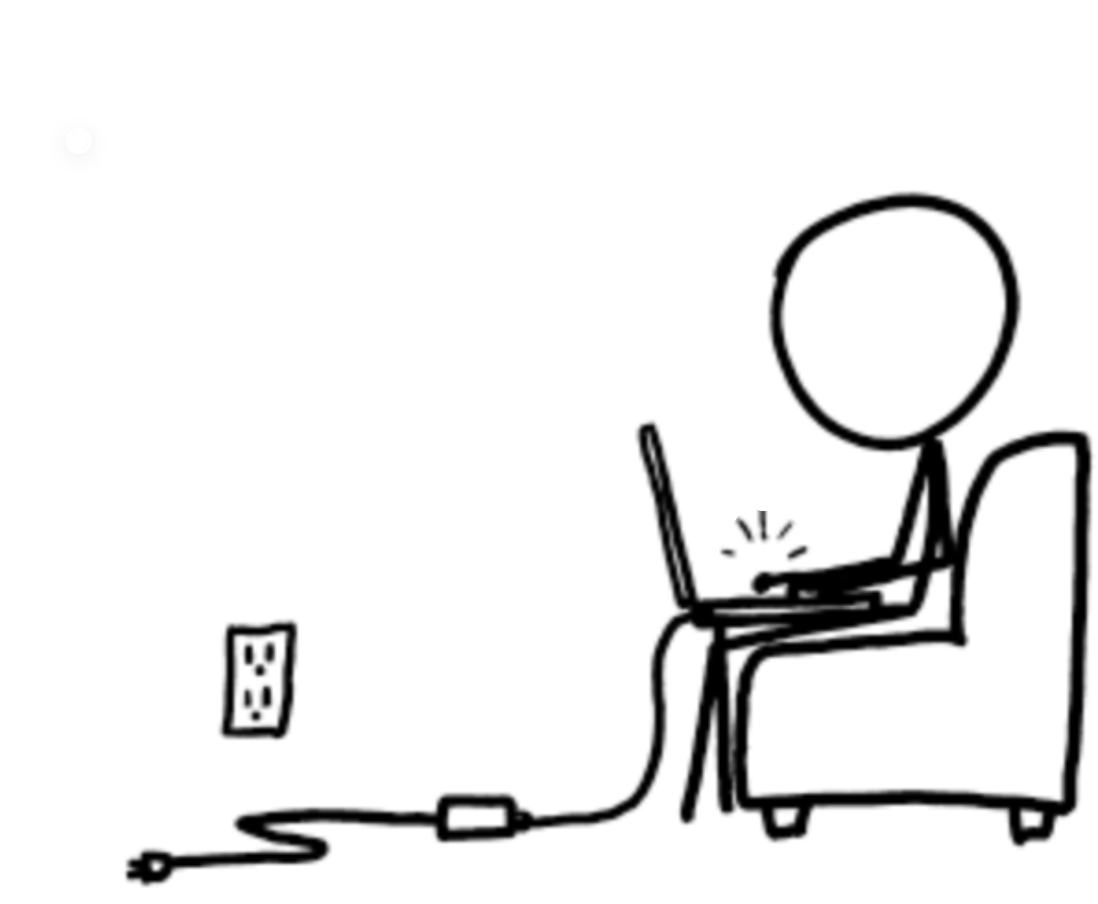
Takeaway
Ledgers can act as parties in distributed protocols
This allows the construction of a more reliable system on top
Any protocol can run on top if it satisfies some basic axioms
BTC
ETH
AVA
https://eprint.iacr.org/2024/210.pdf

Slide 24
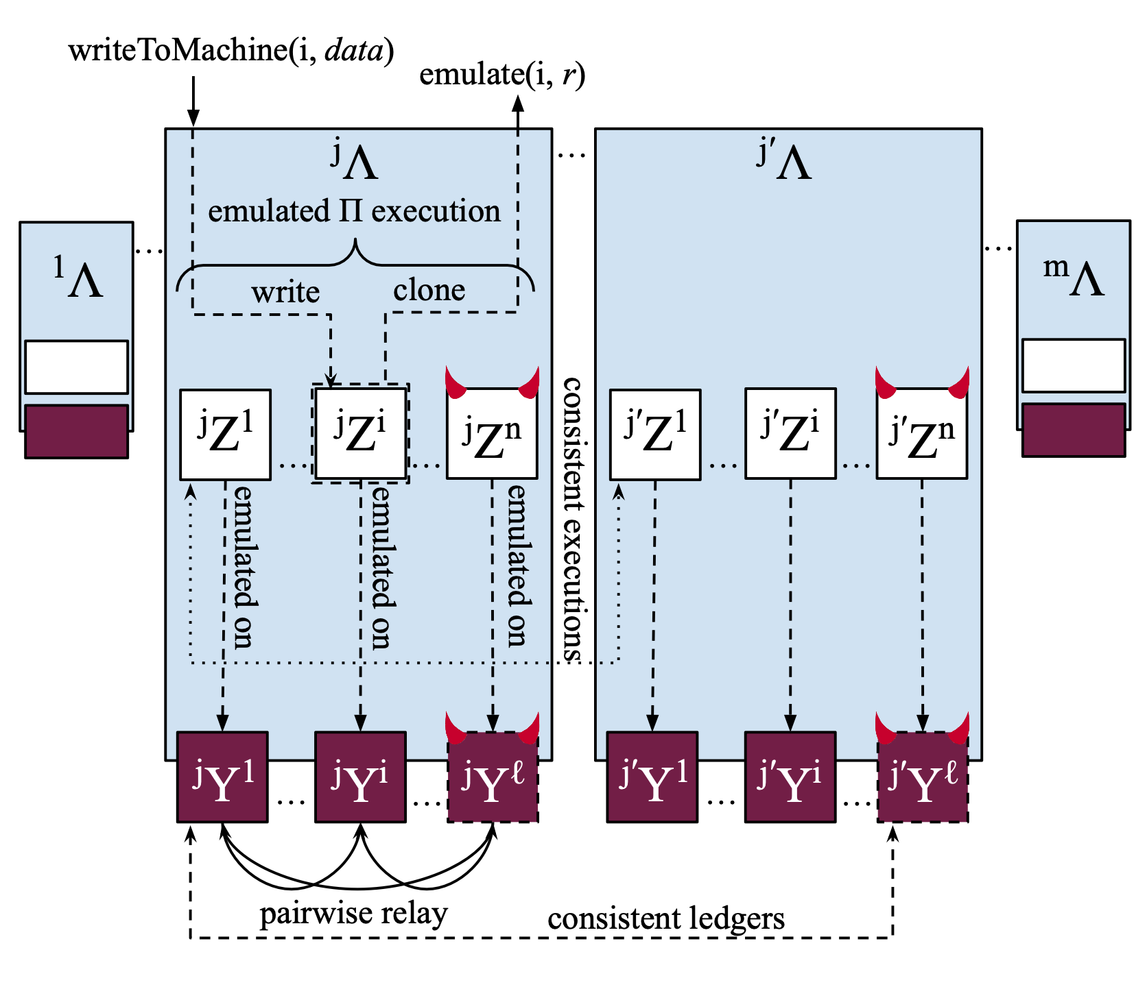

Slide 28
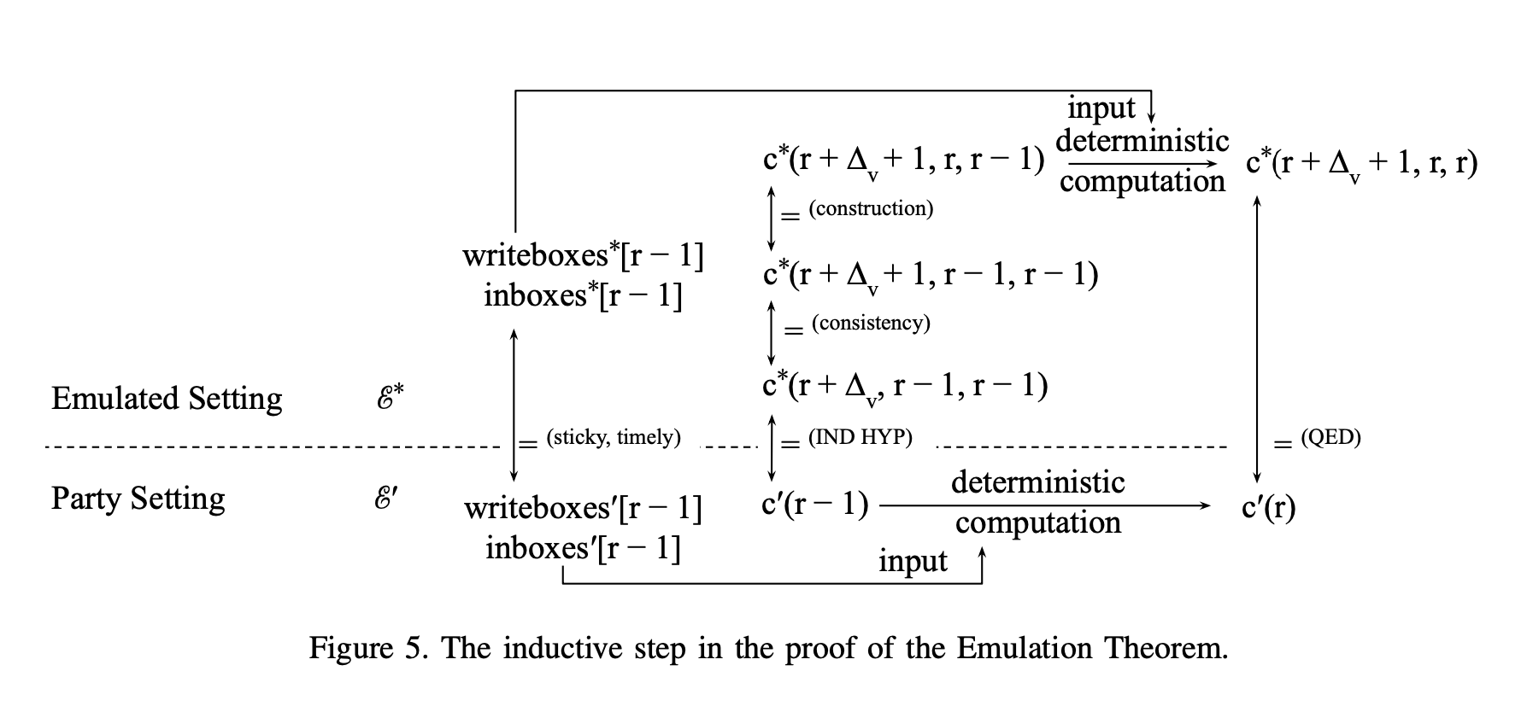

Slide 29
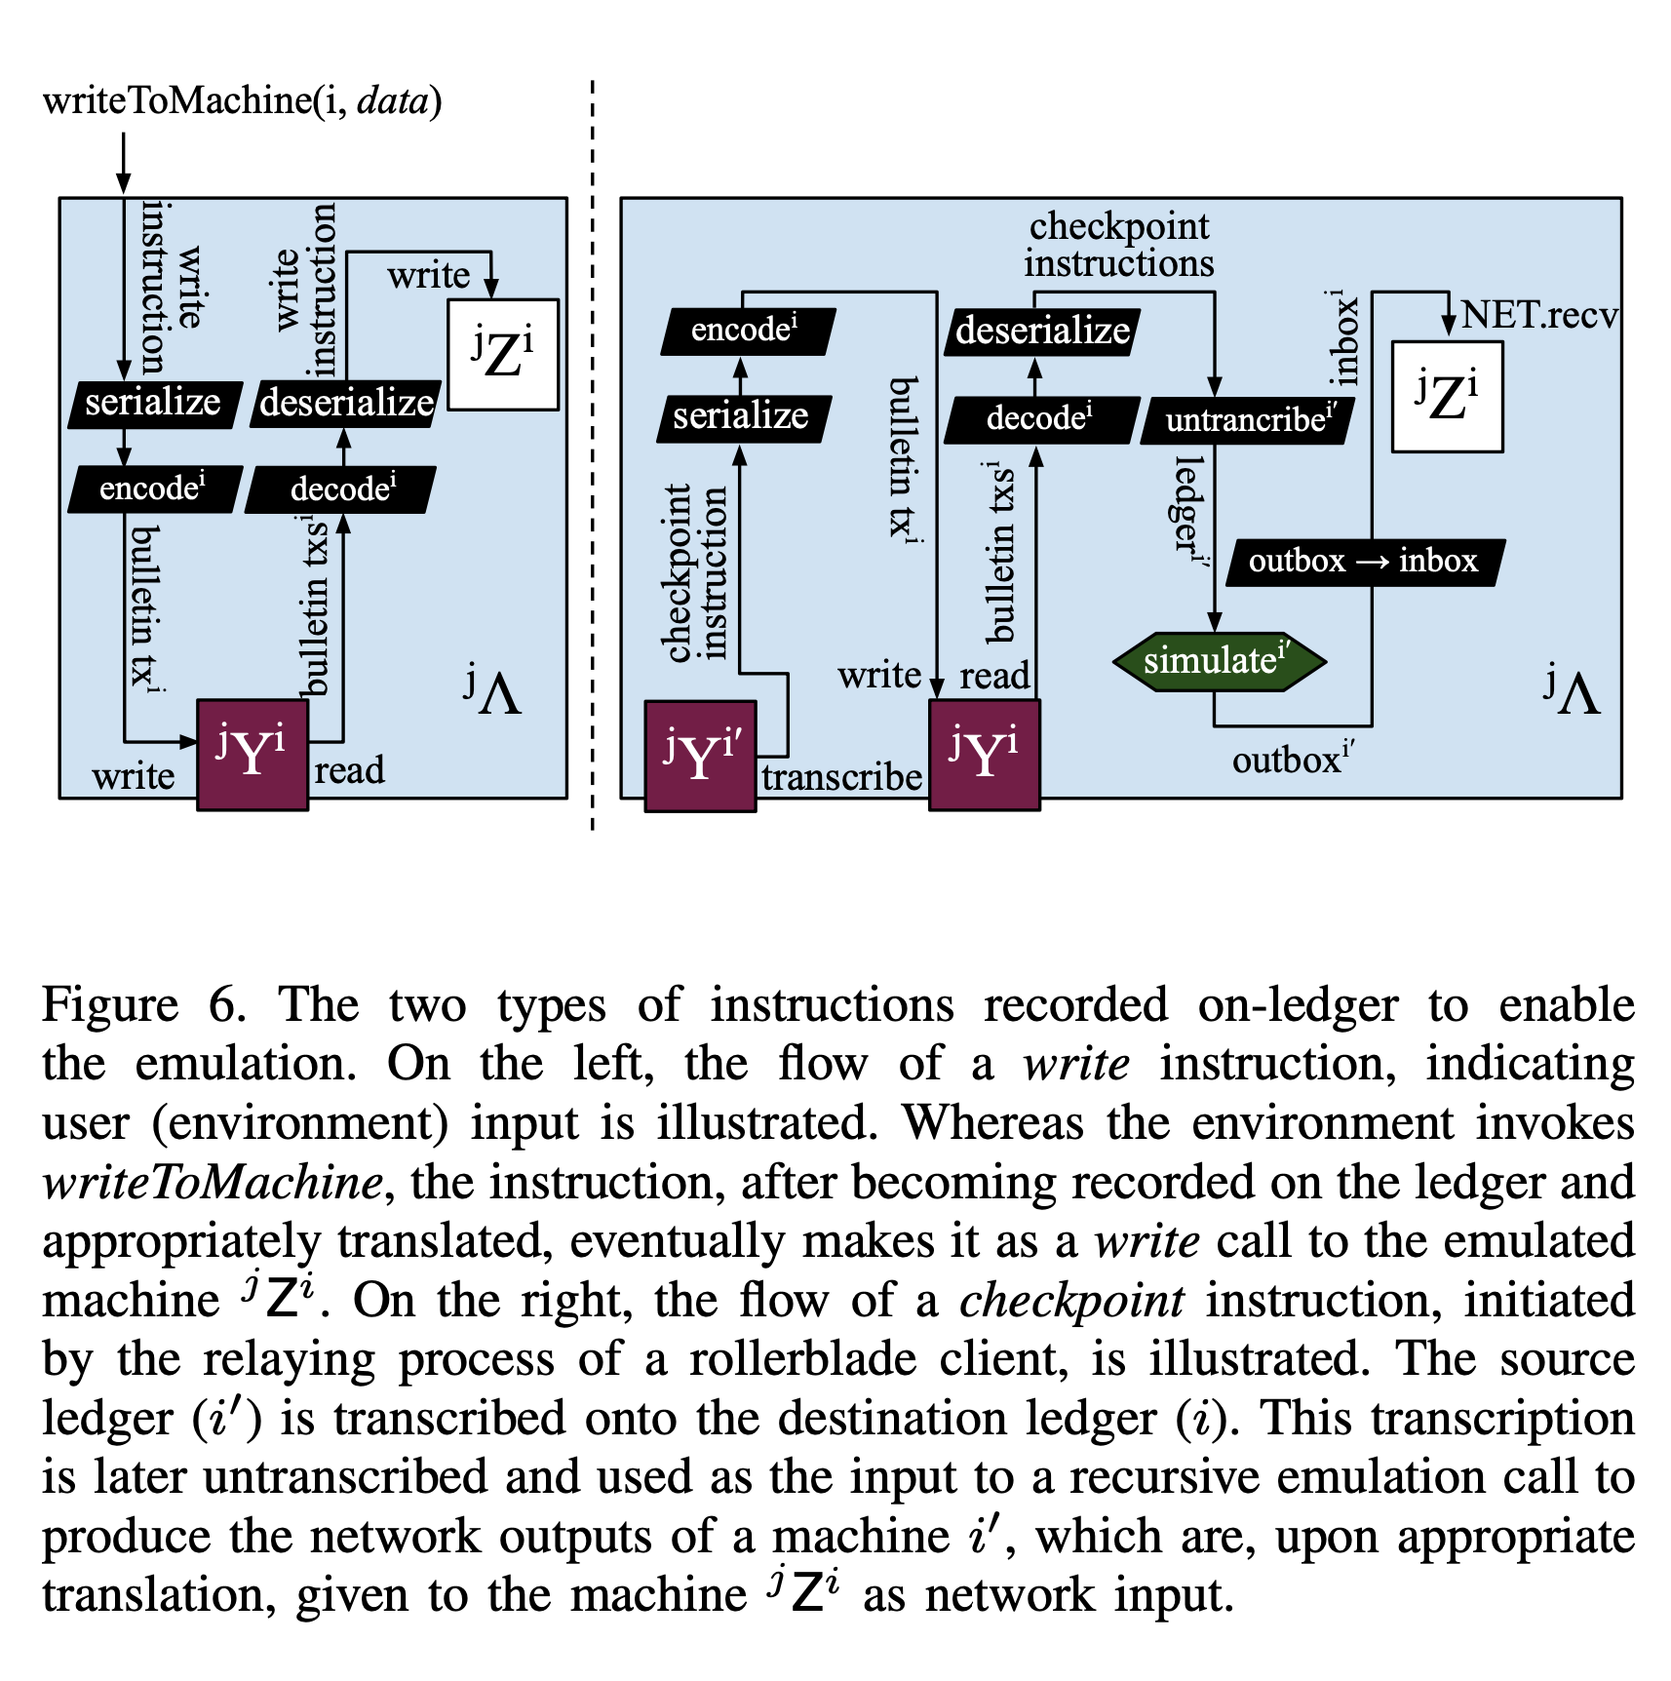

Slide 30
The private keys problem – authenticated channels
Actually, we can’t just run any old Π
Most Πs require secret keys to communicate
But that seems to be an artifact and can be plugged out
We must transform our Πs so that they don’t use signatures
Instead, they use authenticated channels
Send out messages and expect the network to handle the authentication
(Draw Π box with holes)
These protocols are typically called “information theoretic secure”
Examples: IT HotStuff, IT Streamlet (unpublished manuscript)
They are also deterministic outside of an initial seed

Slide 31
Taking a majority vote
The majority of these parties are secure, so we can look at their ledgers
Traverse them transaction-by-transaction
If > f believe in a transaction at a position, include it

Slide 32
Overlay assumptions
Deterministic protocol
Can use public coins
Uses “authenticated channels”
i.e., “information theoretic secure”
e.g., IT HotStuff, IT Streamlet

Slide 33
Underlying assumptions
Safe
Live
Timely
Certifiable
Bulletin

Slide 34
Party–Log analogy
Party | Log
Honest | Secure
Omission fault | Liveness violation
Non-deterministic fault | Safety violation
Byzantine fault | -
Network delay Δ | Liveness u

